Slide 1
MOTIVATIONAL INTRO

Slide 2
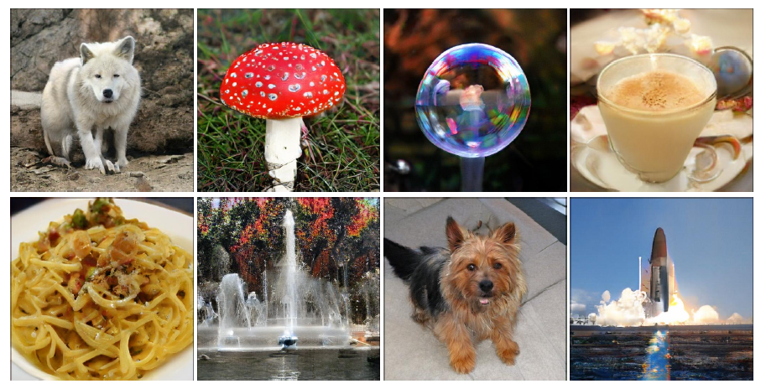

Slide 3
FAKE IMAGES
GENERATED BY NEURAL NETWORK

Slide 4
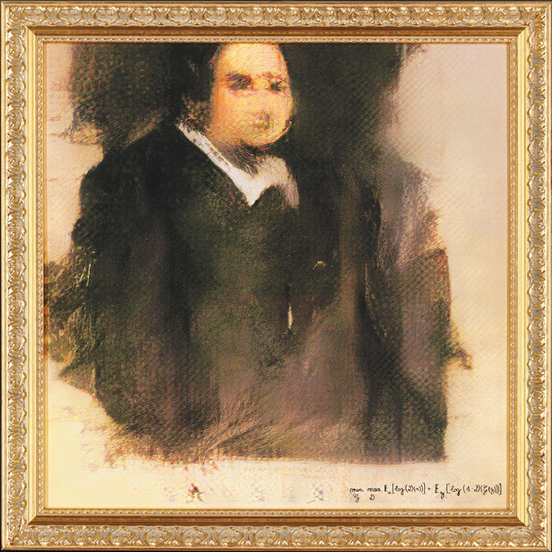

Slide 5
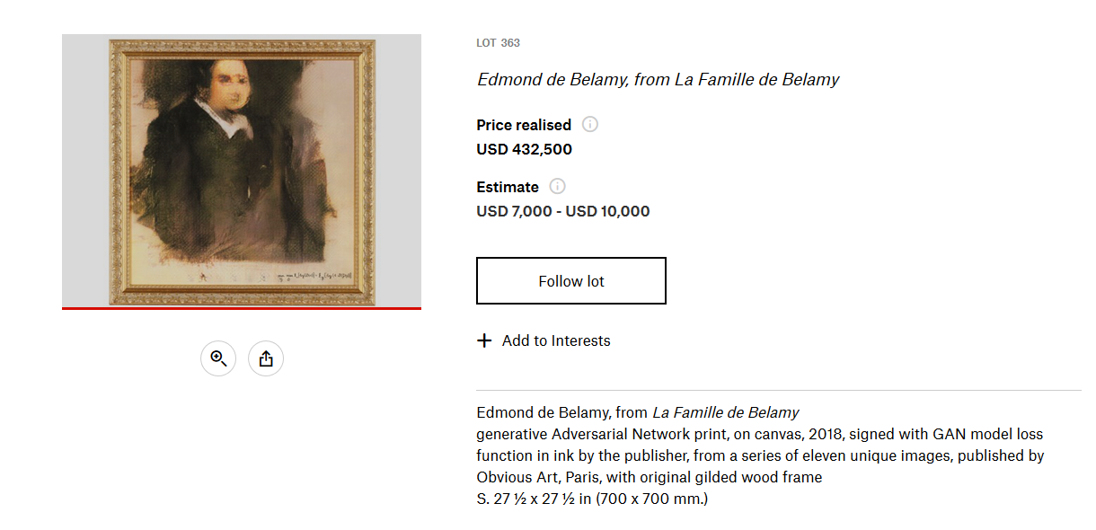
christies - 2018 lot

Slide 6


Slide 7
INTRODUCTION TO
GENERATIVE ADVERSARIAL NETWORK
GAN basic architecture
GAN Lineages
Implement GAN in python
GAN Potentials

Slide 8
Where Is GAN ?

Slide 9
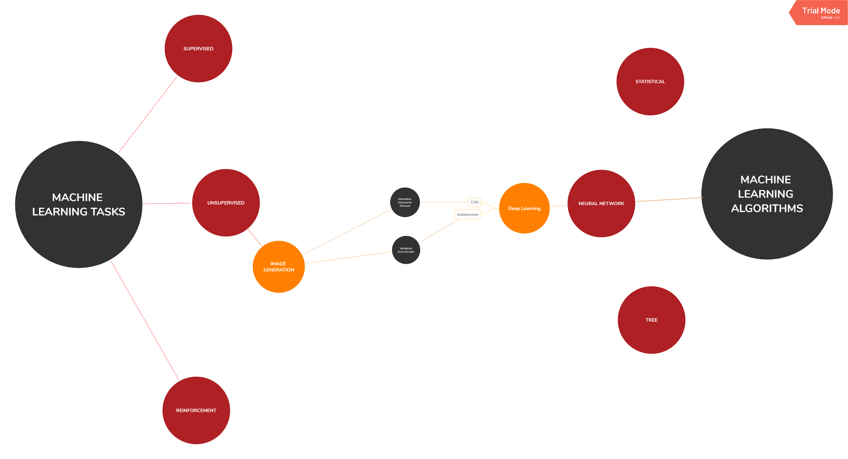

Slide 10
CNN REVIEW

Slide 11
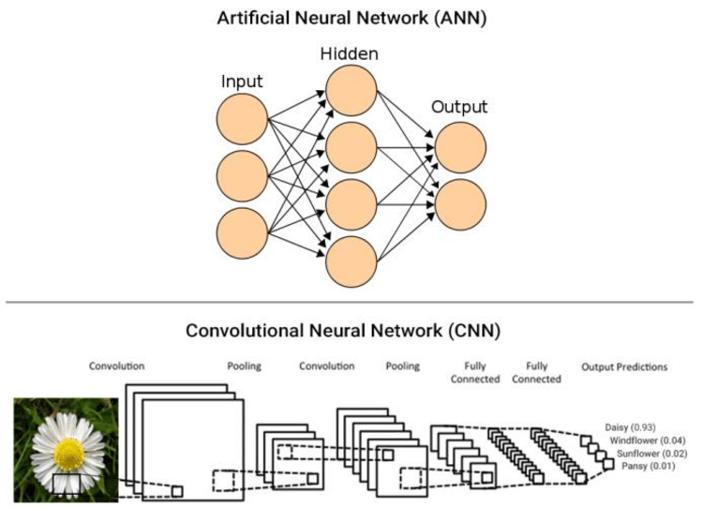

Slide 12
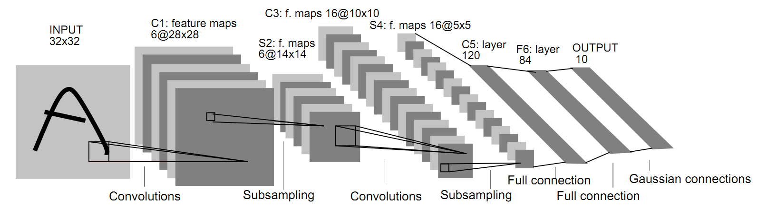

Slide 13
How a machine can create a realistic fake images?
Generative Model

Slide 14
GENERATIVE
DISCRIMINATIVE
Learn data distribution
Learn to distinguish data
Likelihood
Decision Boundary
‌Naïve Bayes
Bayesian networks
Markov random fields
‌Hidden Markov Models (HMM)
‌Logistic regression
Support Vector Machine
‌Traditional neural networks
Conditional Random Field(CRF)s
Andrew NG - Discriminative vs Generative Classifier, 2002

Slide 15
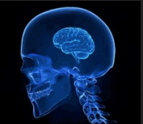
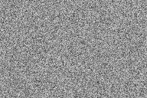
What Is GAN
Level 0 : Concept
GAN
Random Noise
Fake Data
Train Data

Slide 16
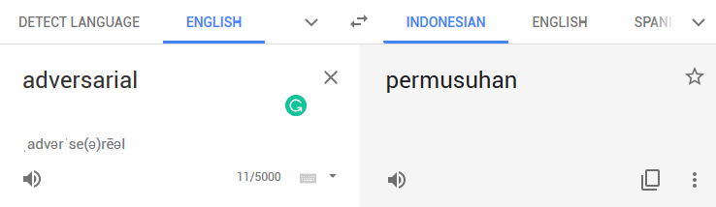

ADVERSARIAL

Slide 17
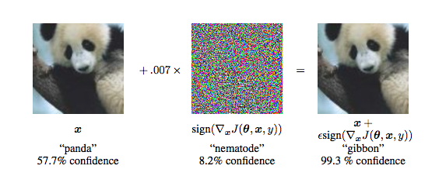
ADVERSARIAL EXAMPLE
Goodfellow et al - Explaining and Harnessing Adversarial Example, 2014

Slide 18
GAN LINEAGE

Slide 19
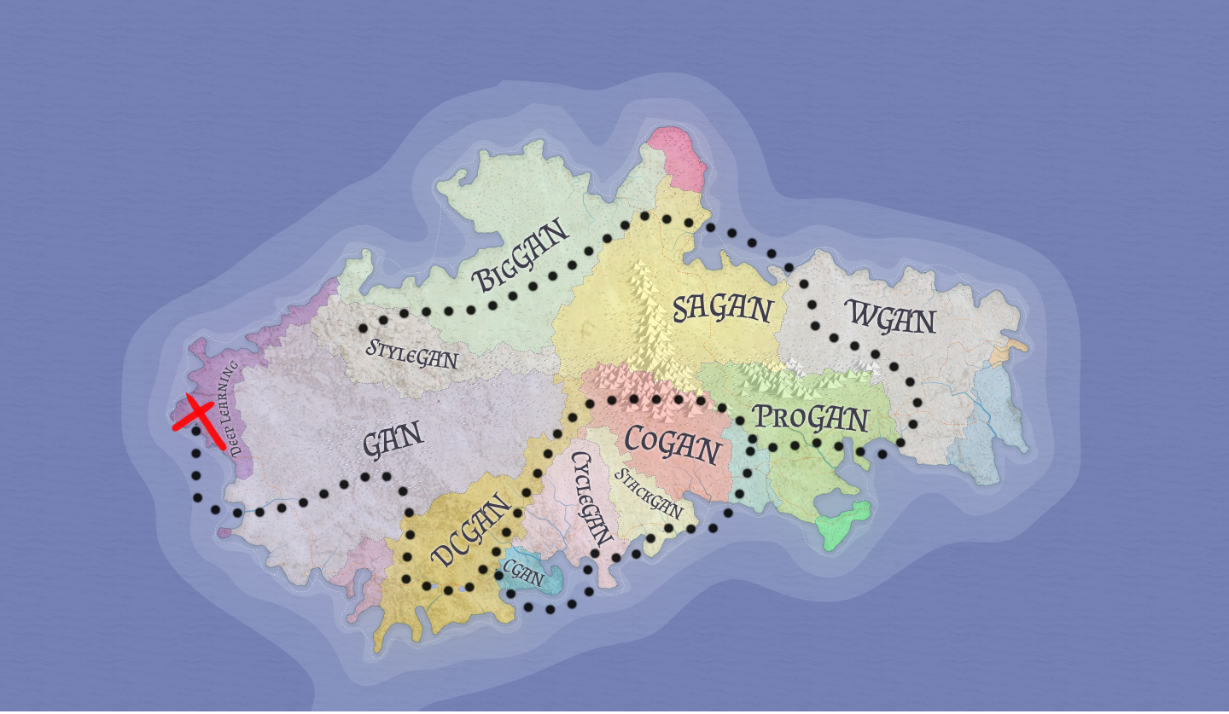

Slide 20

2014 : Ian Goodfellow Train NN for Adversarial Example
2014 : Ian Goodfellow Created GAN
https://arxiv.org/abs/1412.6572
https://arxiv.org/abs/1406.2661
GANFATHER
Ian J. Goodfellow

Slide 21
What Is GAN
Level 0 : Concept
G
D
Random Noise
Fake Data
Train Data

Slide 22
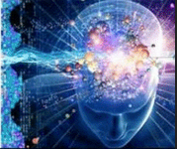
What Is GAN
Level 1 : Basic Architecture
Train Data (real)
G
D
FAKE
Fake Data
REAL
Random Noise
Generator
Discriminator

Slide 23
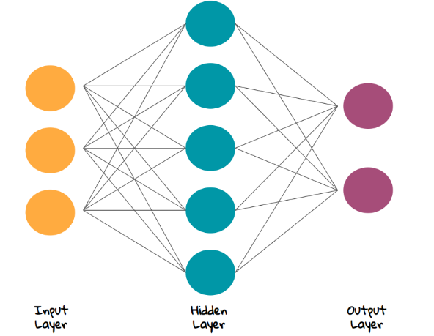
What Is GAN
Level 1 : Basic Architecture
Train Data (real)
FAKE
Fake Data
REAL
Random Noise
Generator
Discriminator

Slide 24

What Is GAN
Level 2 : Learning Process
Cross-entropy
Minimax Loss
Wassertein Loss
Inception Score : Improved Technique for Training GANs
Train Data (real)
FAKE
LOSS
Fake Data
REAL
Random Noise
Generator
Discriminator

Slide 25
What Is GAN
Level 2 : Learning Process
Cross-entropy
Minimax Loss
Wassertein Loss
Inception Score : Improved Technique for Training GANs
Train Data (real)
FAKE
LOSS
Fake Data
REAL
Random Noise
Generator
Discriminator

Slide 27
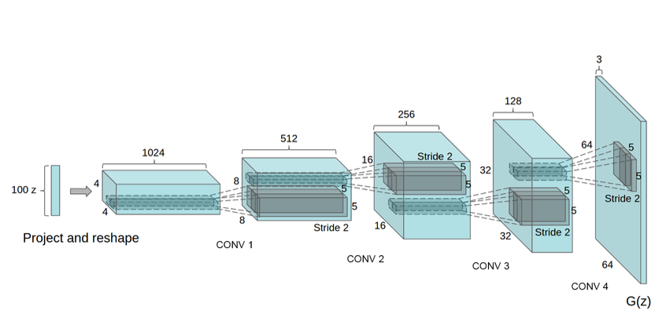
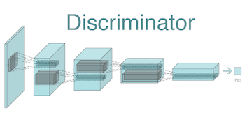
DCGAN

Slide 28
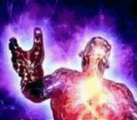
What Is GAN
Level 3 : Data Flow and Transformation
Train Data (real)
FAKE
LOSS
Fake Data
REAL
Random Noise
Generator
Discriminator

Slide 29

What Is GAN
Level 3 : Data Flow and Transformation
Train Data (real)
FAKE
LOSS
Fake Data
REAL
Random Noise
Generator
Discriminator

Slide 30
What Is GAN
Level 3 : Data Flow and Transformation
Random Noise
Generator
Fake Data
1. Dense
2. Reshape : Turn into 2d
3. Upsampling2D : Make a larger image
Readmore: Conv2dTranspose (Deconvolution)
4. Conv2D

Slide 31
What Is GAN
Level 3 : Data Flow and Transformation
FAKE
LOSS
REAL
Discriminator
1. Conv2d
2. Pooling / Subsampling
3. Flatten (turn into 1d)
4. Dense

Slide 33
What Is GAN
Level 3 : Data Flow and Transformation
Train Data (real)
FAKE
LOSS
Fake Data
REAL
Random Noise
Generator
Discriminator
1. Dense
1. Conv2d
2. Reshape : Turn into 2d
2. Pooling / Subsampling
3. Upsampling2D : Make a larger image
3. Flatten (turn into 1d)
4. Conv2D
4. Dense

Slide 34
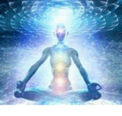
What Is GAN
Level 4: How to Train your GAN
Explained in Implementation Later
Train Data (real)
FAKE
LOSS
Fake Data
REAL
Random Noise
Generator
Discriminator

Slide 35
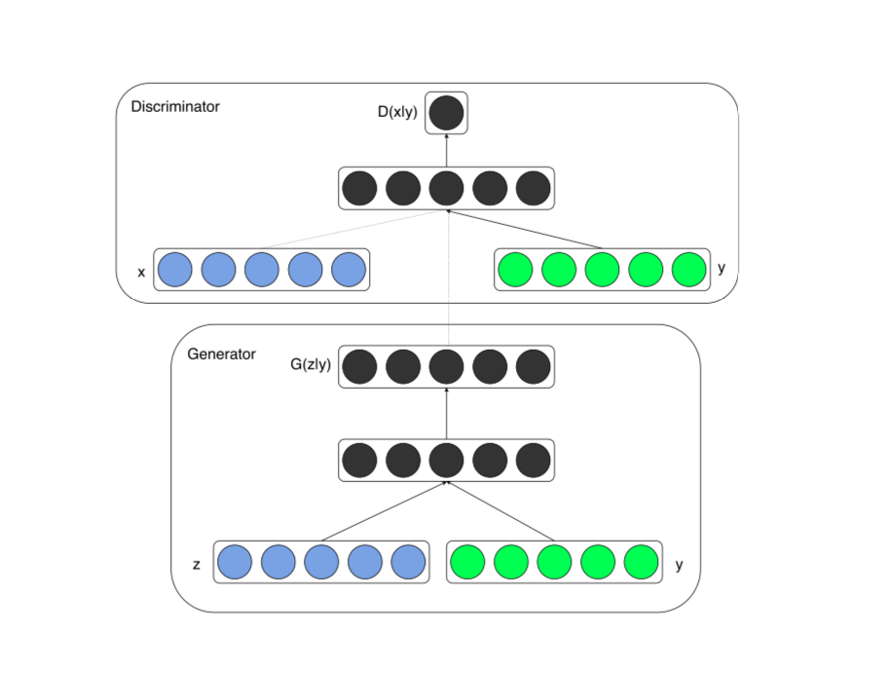
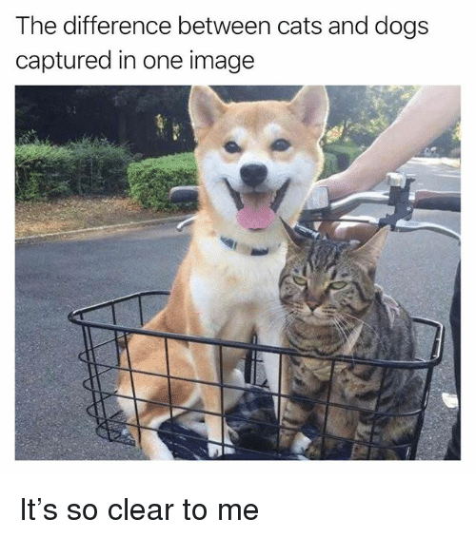
CGAN (Conditional GAN)

Slide 36
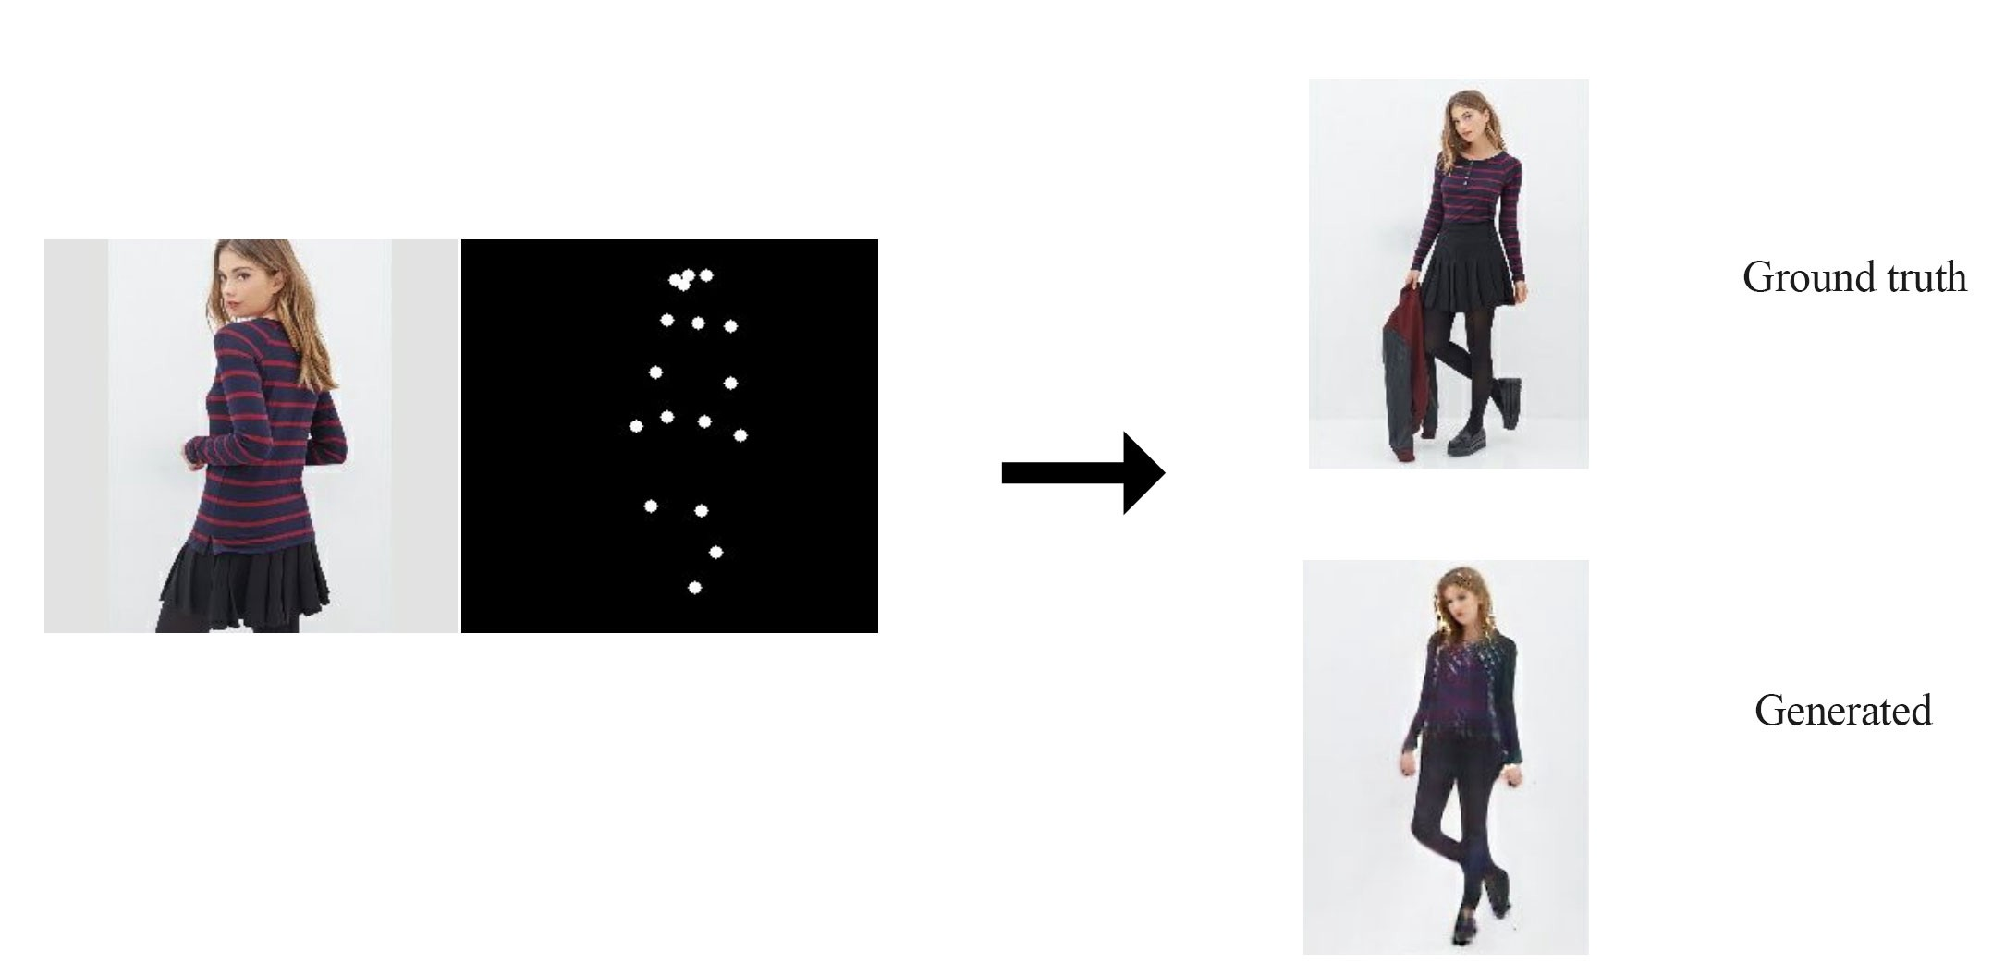
CGAN (Conditional GAN)

Slide 37

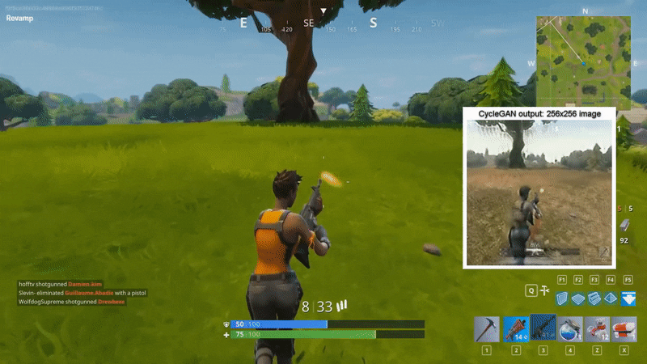
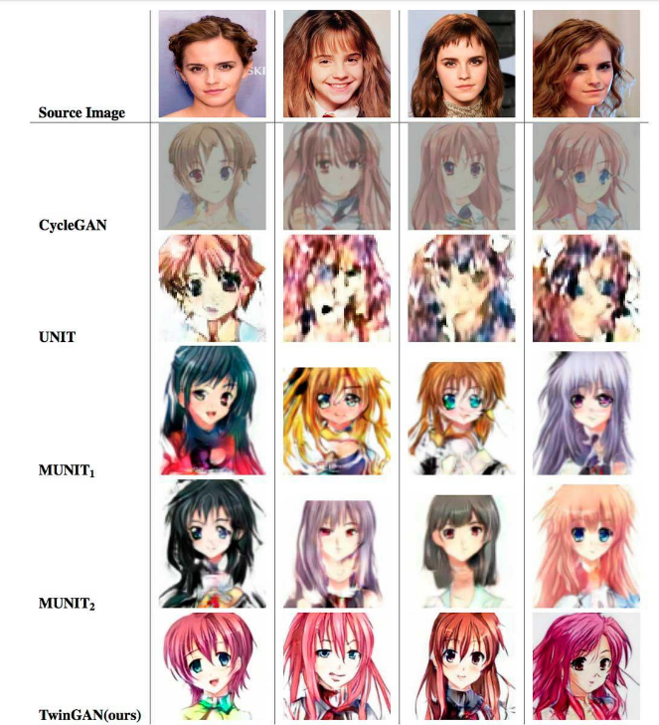
CycleGAN

Slide 38
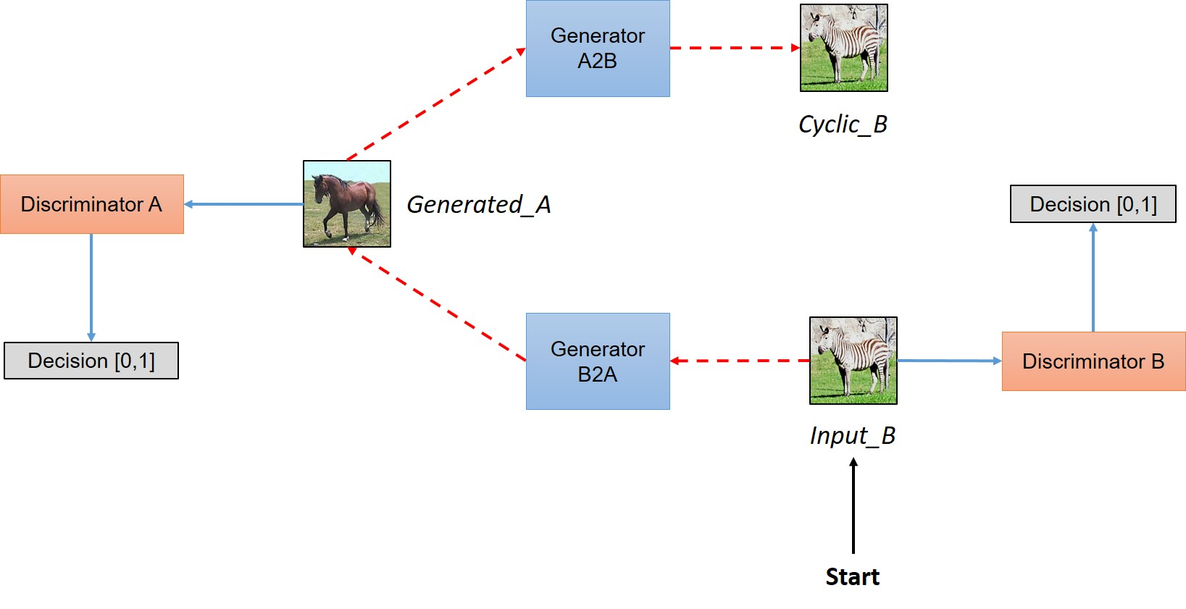
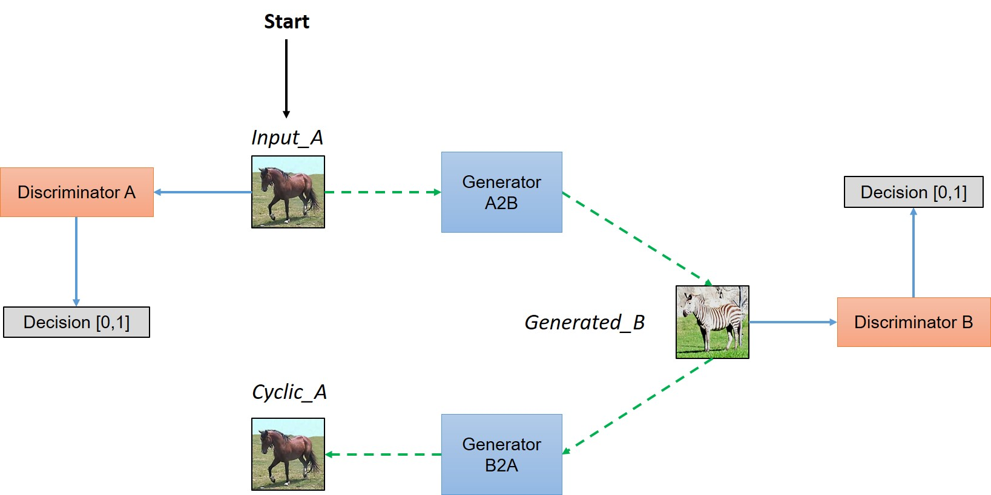
CycleGAN

Slide 39
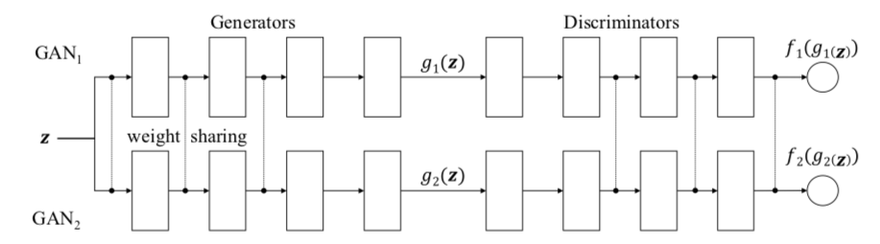
CoGAN (Coupled GAN)

Slide 40
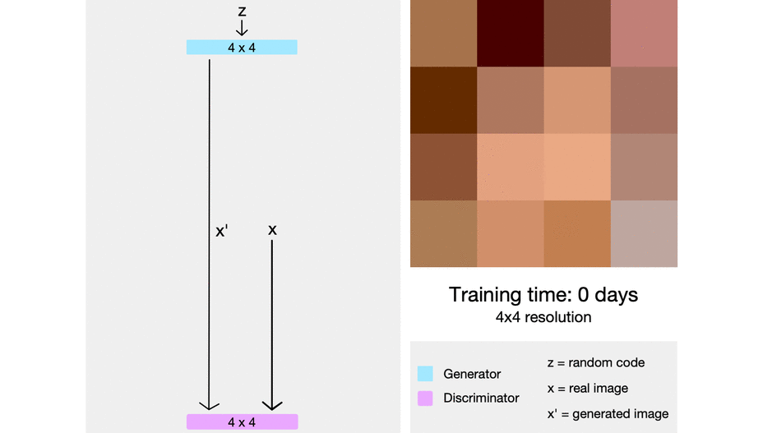
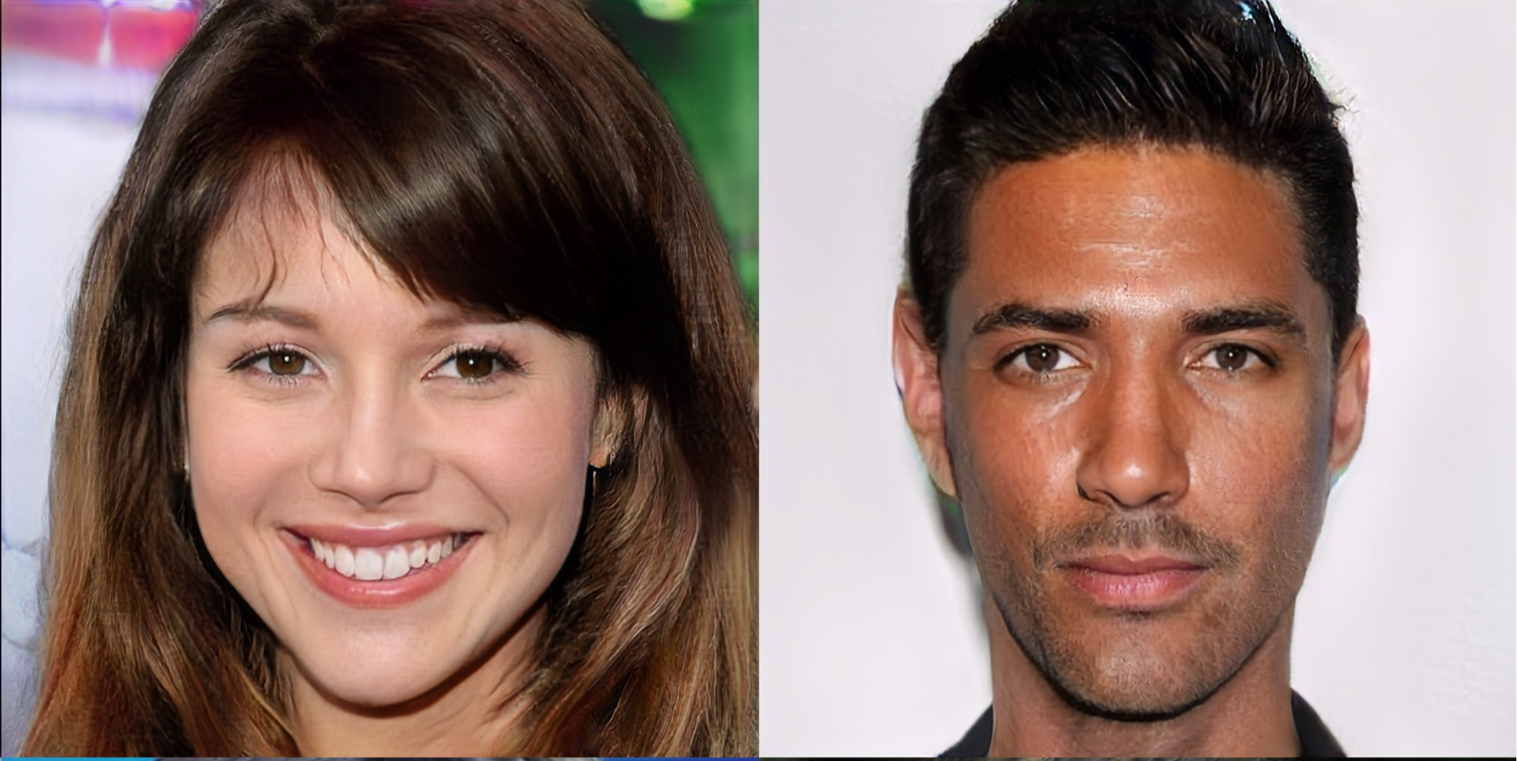
ProGAN (Progressive GAN)

Slide 41
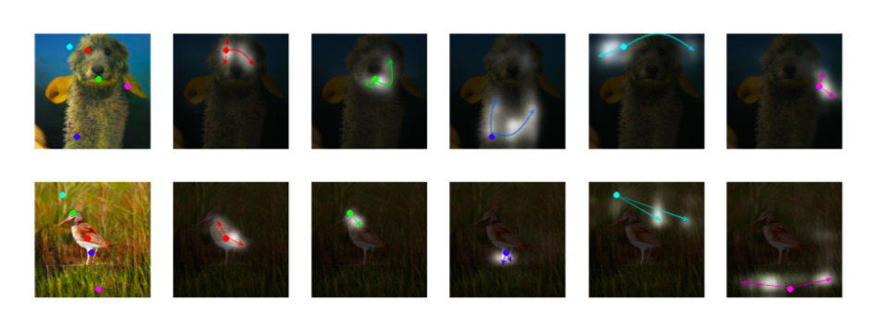
SAGAN (Self Attention GAN) : Context Power

Slide 42
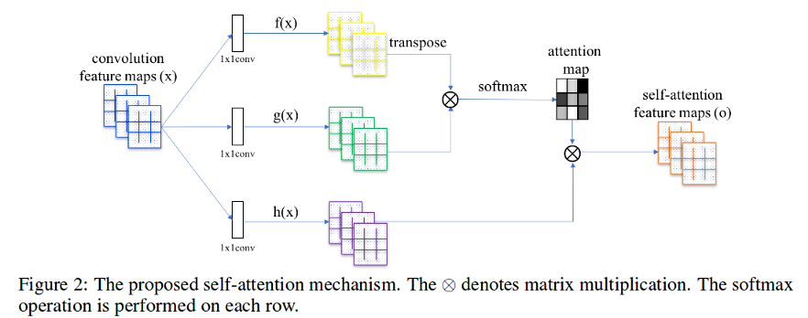
SAGAN (Self Attention GAN)

Slide 43
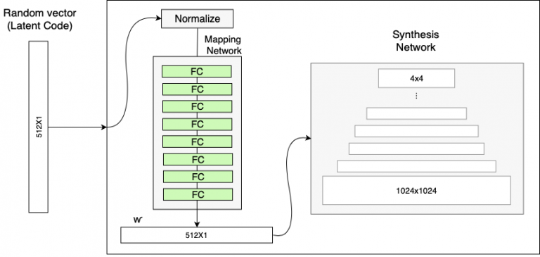
StyleGAN : Full Control GAN

Slide 44
StyleGAN : Full Control GAN
https://www.youtube.com/watch?v=kSLJriaOumA

Slide 45
GOOD
GAN POTENSIALS
OR
BAD ?

Slide 46
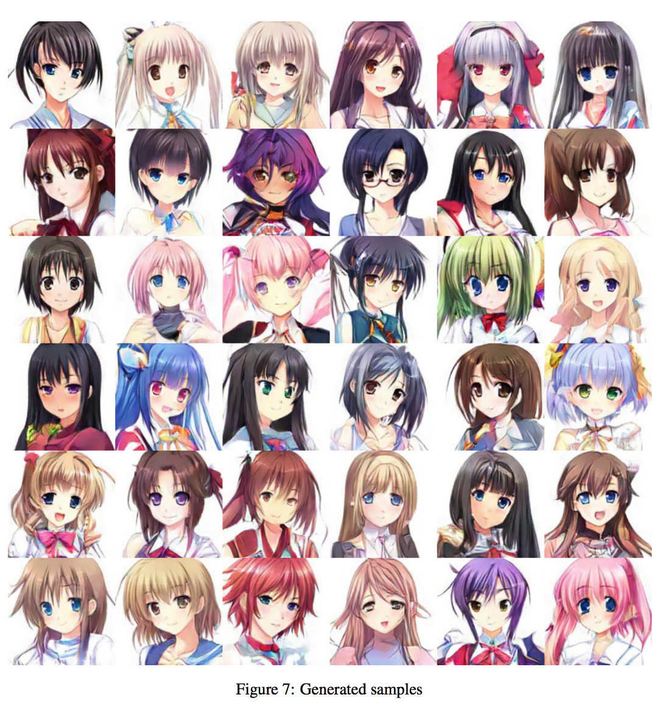
Virtual Character

Slide 47
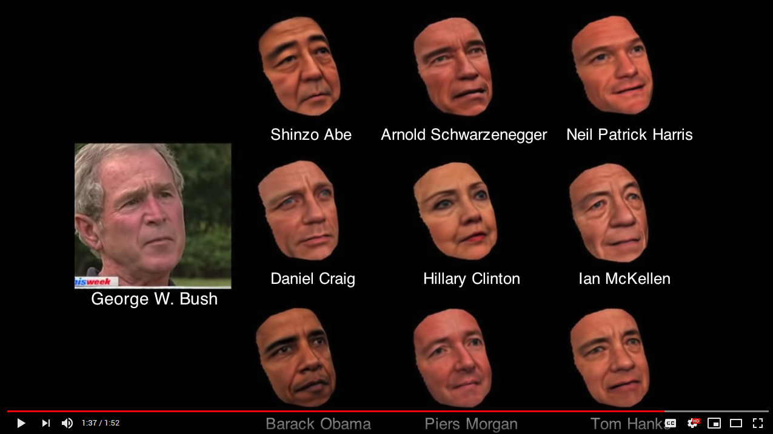
DEEPFAKE

Slide 48
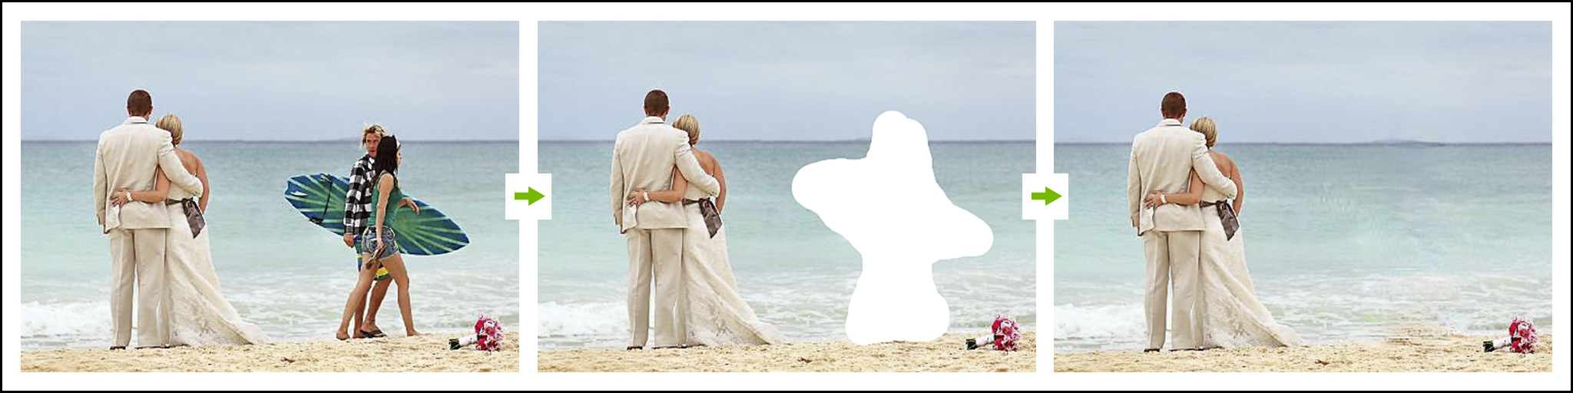
inpainting
Demo : https://www.nvidia.com/research/inpainting/

Slide 49

Music Styling and Generation
Latent Vector
Interpolated
Read more : SynthGAN

Slide 50
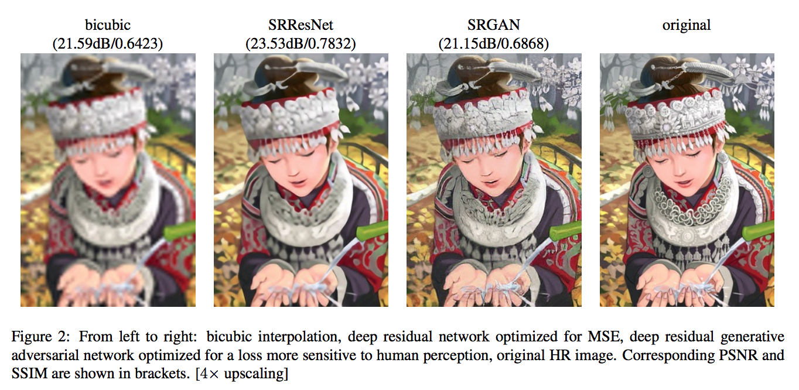
Super Resolution

Slide 51
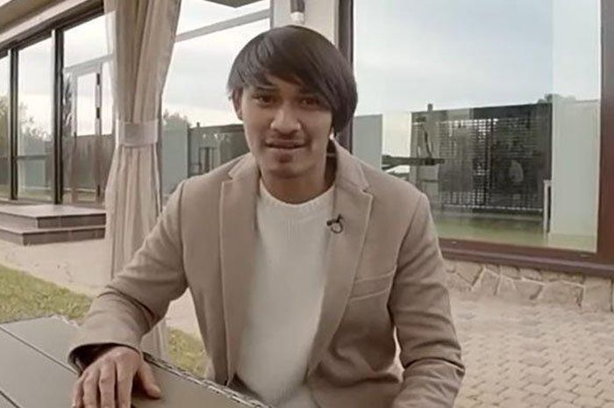

Slide 52
now is better than never
YOU GAN DO IT

